Slide 1
Update on Using Agentic AI to Explore Systems Thinking

Slide 2
Briefly…
Used chaining of instructions to (i) identify primary variables; (ii) breakdown into sub-factors; (iii) identify causal relationship; (iv) identify (reinforcement/balancing) feedback loops
Instructions were then used to output into Graphviz and generate into rudimentary CLD
Compared the effectiveness of the chain of instruction against 20 case studies used by SD Bot paper.

Slide 3
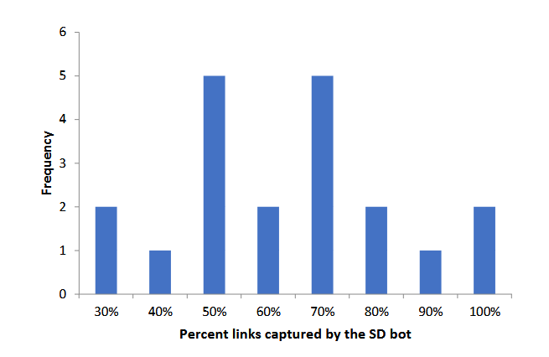
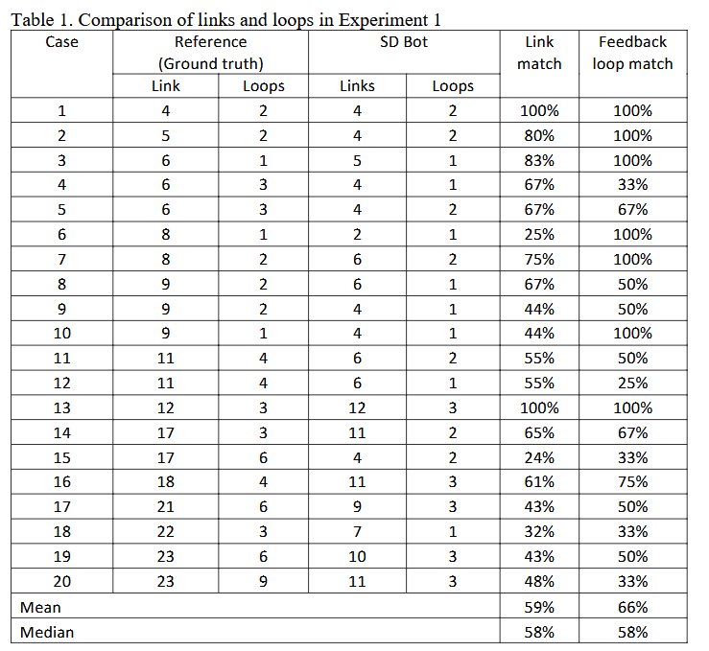
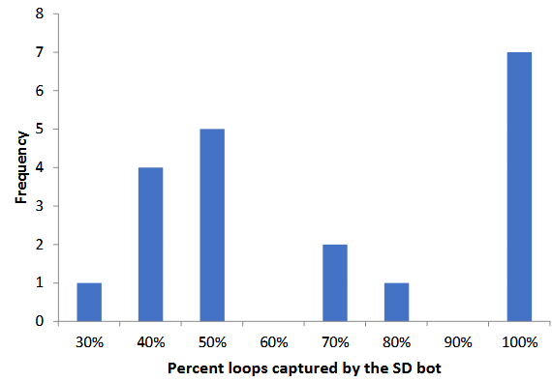
SD Bot Experiment 1 Results

Slide 4
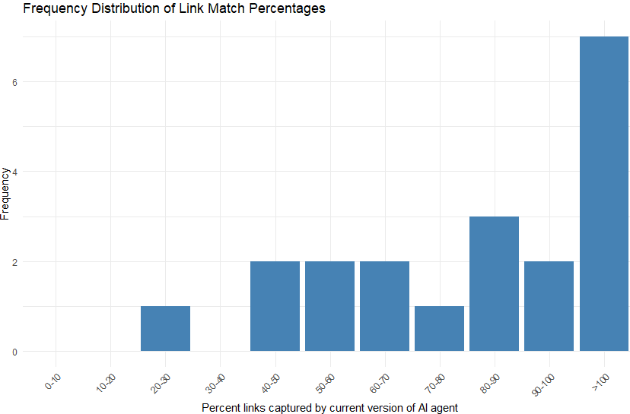
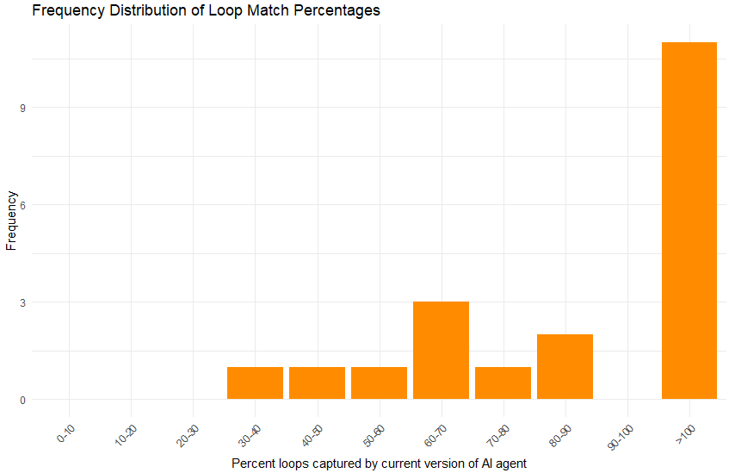
AI agent version
Case | # of links in the text | # of loops in the text | AI_link | AI_loop | Link match | Feedback loop match
1 | 4 | 2 | 4 | 2 | 100% | 100%
2 | 5 | 2 | 4 | 4 | 80% | 200%
3 | 6 | 1 | 6 | 1 | 100% | 100%
4 | 6 | 3 | 6 | 1 | 100% | 33%
5 | 6 | 3 | 7 | 2 | 117% | 67%
6 | 8 | 1 | 8 | 2 | 100% | 200%
7 | 8 | 2 | 8 | 2 | 100% | 100%
8 | 9 | 2 | 8 | 2 | 89% | 100%
9 | 9 | 2 | 4 | 2 | 44% | 100%
10 | 9 | 1 | 4 | 1 | 44% | 100%
11 | 11 | 4 | 11 | 3 | 100% | 75%
12 | 11 | 4 | 9 | 2 | 82% | 50%
13 | 12 | 3 | 11 | 3 | 92% | 100%
14 | 17 | 3 | 13 | 3 | 76% | 100%
15 | 17 | 6 | 10 | 4 | 59% | 67%
16 | 18 | 4 | 17 | 5 | 94% | 125%
17 | 21 | 6 | 13 | 5 | 62% | 83%
18 | 22 | 3 | 6 | 2 | 27% | 67%
19 | 23 | 6 | 15 | 5 | 65% | 83%
20 | 23 | 9 | 12 | 4 | 52% | 44%

Slide 5
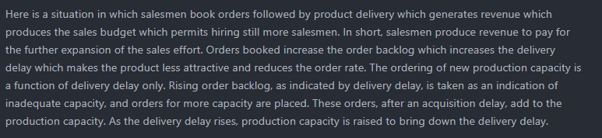
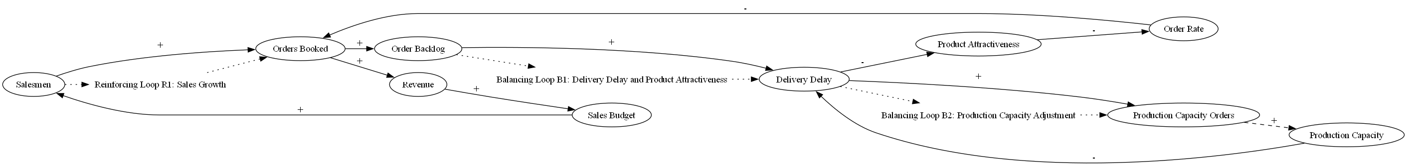
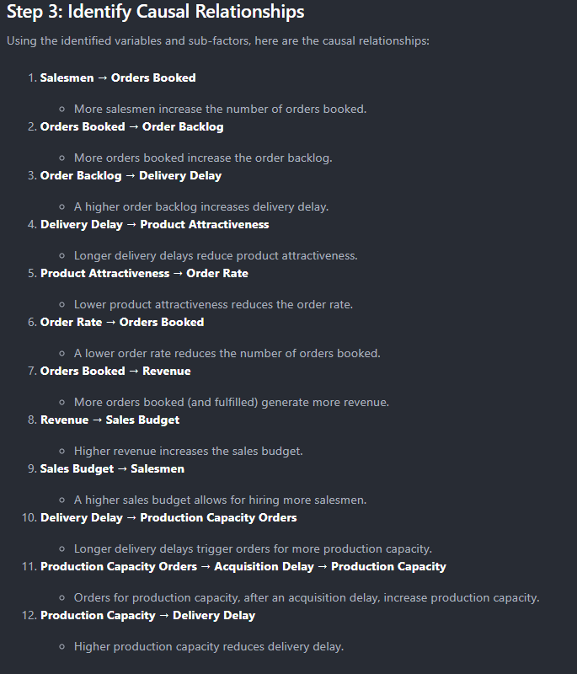
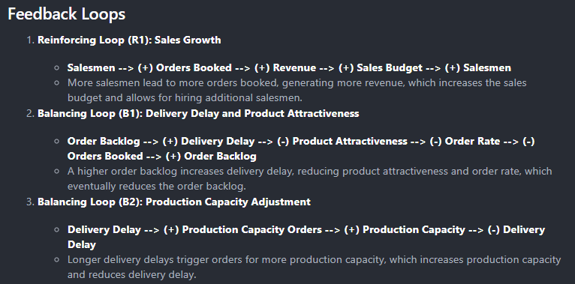
Case 13

